Slide 1

Precipitation prediction
Dor sandler
Rotem balter
Roni admon

Slide 6
CASPNET
Sara Sabour, Nicholas Frosst, Geoffrey E Hinton. Dynamic Routing Between Capsules. NIPS 2017
Xifeng Guo - https://github.com/XifengGuo/CapsNet-Keras

Slide 7
CASPNET
Originally trained on MNIST, detecting multiple classes
Motivation: pattern recognition
Key feature – Routing by agreement

Slide 8
Capsules
Usually in a Neural Network we care about the existence of the pattern, but in order to know how it exists we use a concept called capsules
We call a group of neuron a capsule and refer to the relation between them – an object is made from several parts and it only exist if all the parts exist in the proper manner

Slide 9
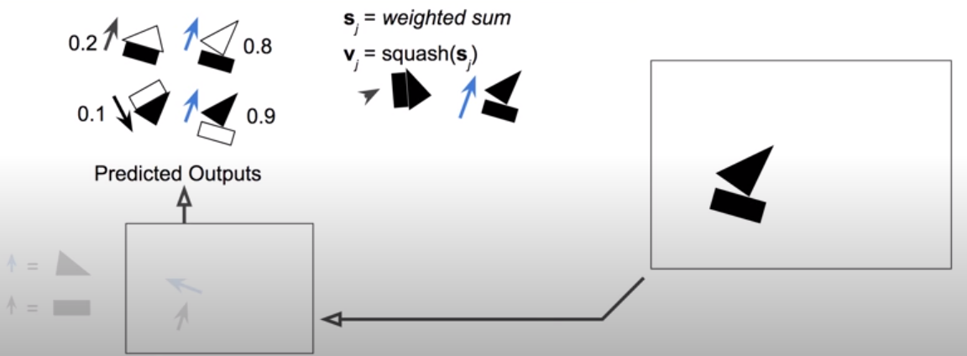
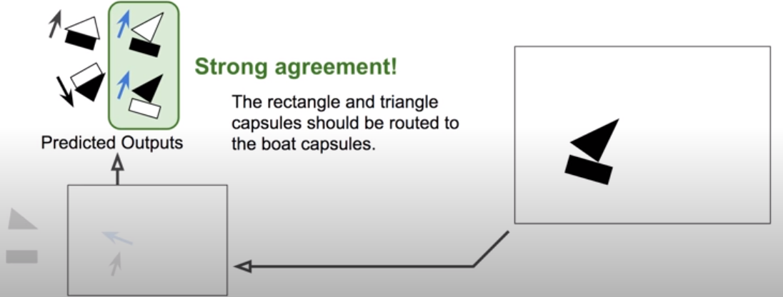
Routing by agreement
Summing the vectors – low level capsules
Finding clusters of agreement and routing only them to higher level capsules
We used 5 routing iteration
Notes:
Take for example this picture on the right which is complexed from a triangle and a rectangle , and let say it can make a house or a boat, so we have 2 higher capsules
each part separately tries to predict the whole object’s size and direction, thus also for the other parts

Slide 10
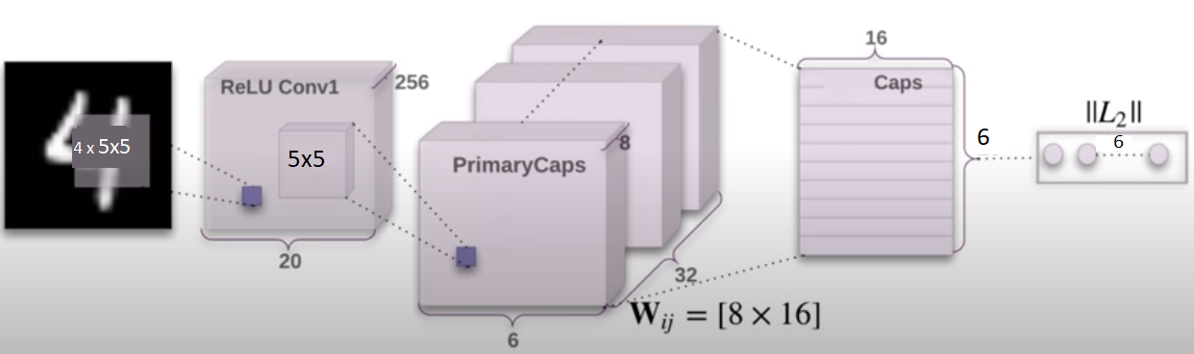
Starts as fully connected

Slide 11
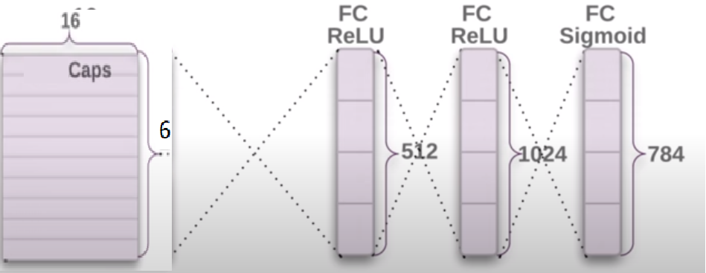
Decoder – reconstructing image

Slide 12
Pros // Cons
Requires less training data
Routing by agreement is great for overlapping
Position and pose data are preserved
Activations nicely map hierarchy of parts
Cannot see 2 identical very close objects (crowding)
Routing by agreement inner loop makes slow training

